Slide 1

Testing Software for Bias
Ethics & Equity in Software Engineering

Slide 2
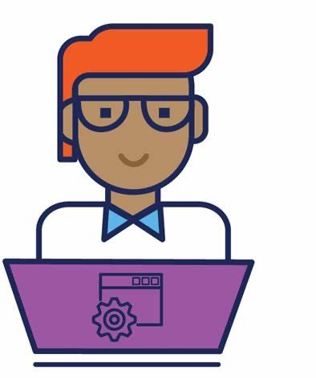
Software engineers have power.
Software is everywhere.
As builders of technology, we have power to influence a lot…
Healthcare
Criminal justice
Resource allocation
The list literally goes on!
The decisions we make influences the software that gets shipped to the world.

Slide 3
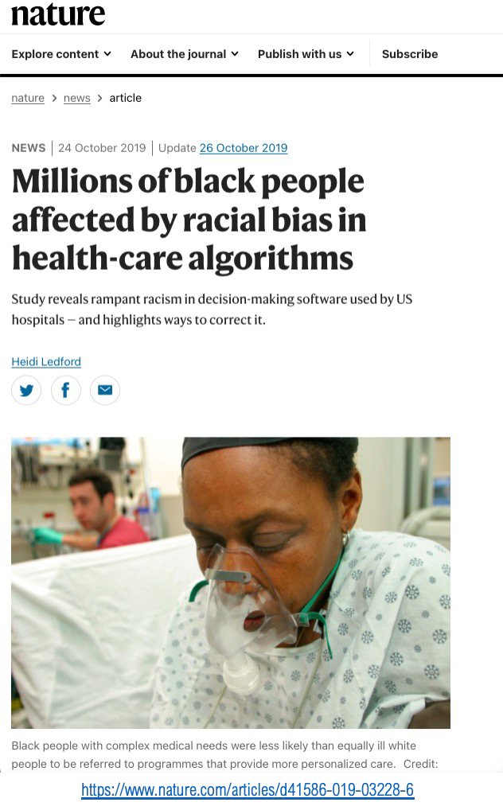
The power in decisions
Given the findings, explored other options:
Other costs (e.g., future avoidable costs)
Number active chronic conditions
Conducted series of experiments to evaluate outcomes
Worked with company to improve the algorithm
The ethical decision to evaluate a variety of options
led to a more equitable algorithm.
Obermeyer, Z., Powers, B., Vogeli, C., & Mullainathan, S. (2019). Dissecting racial bias in an algorithm used to manage the health of populations. Science, 366(6464), 447-453.

Slide 4
Supporting ethical decision-making
"Where there's a will, there's a way"…
But what if the will is present, without an effective way?
Studies suggest software engineers want to, but often don't have
Sufficient power [1]
Effective tool support [2, 3]
[1] Widder, David Gray, et al. "It’s about power: What ethical concerns do software engineers have, and what do they (feel they can) do about them?." Proceedings of the 2023 ACM Conference on Fairness, Accountability, and Transparency. 2023.
[2] Ayling, Jacqui, and Adriane Chapman. "Putting AI ethics to work: are the tools fit for purpose?." AI and Ethics 2.3 (2022): 405-429.
[3] de Souza Santos, Ronnie, et al. "Software fairness testing in practice." 2025 IEEE International Conference on Software Maintenance and Evolution (ICSME). IEEE, 2025.

Slide 5
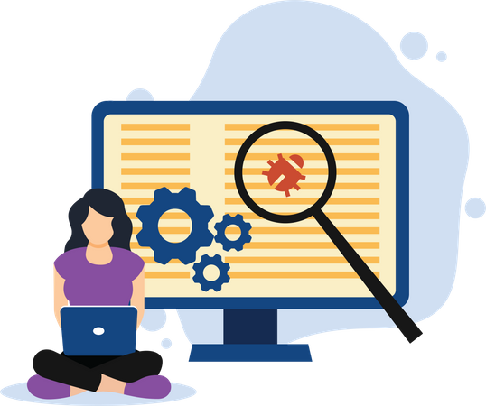
Leveraging existing skills
Software engineers already equipped with relevant skills.
Testing emerged as critical consideration (and opportunity).
We can test for fairness (and other concerns) by evaluating how our software discriminates (or makes decisions).
But how do we do that?

Slide 6


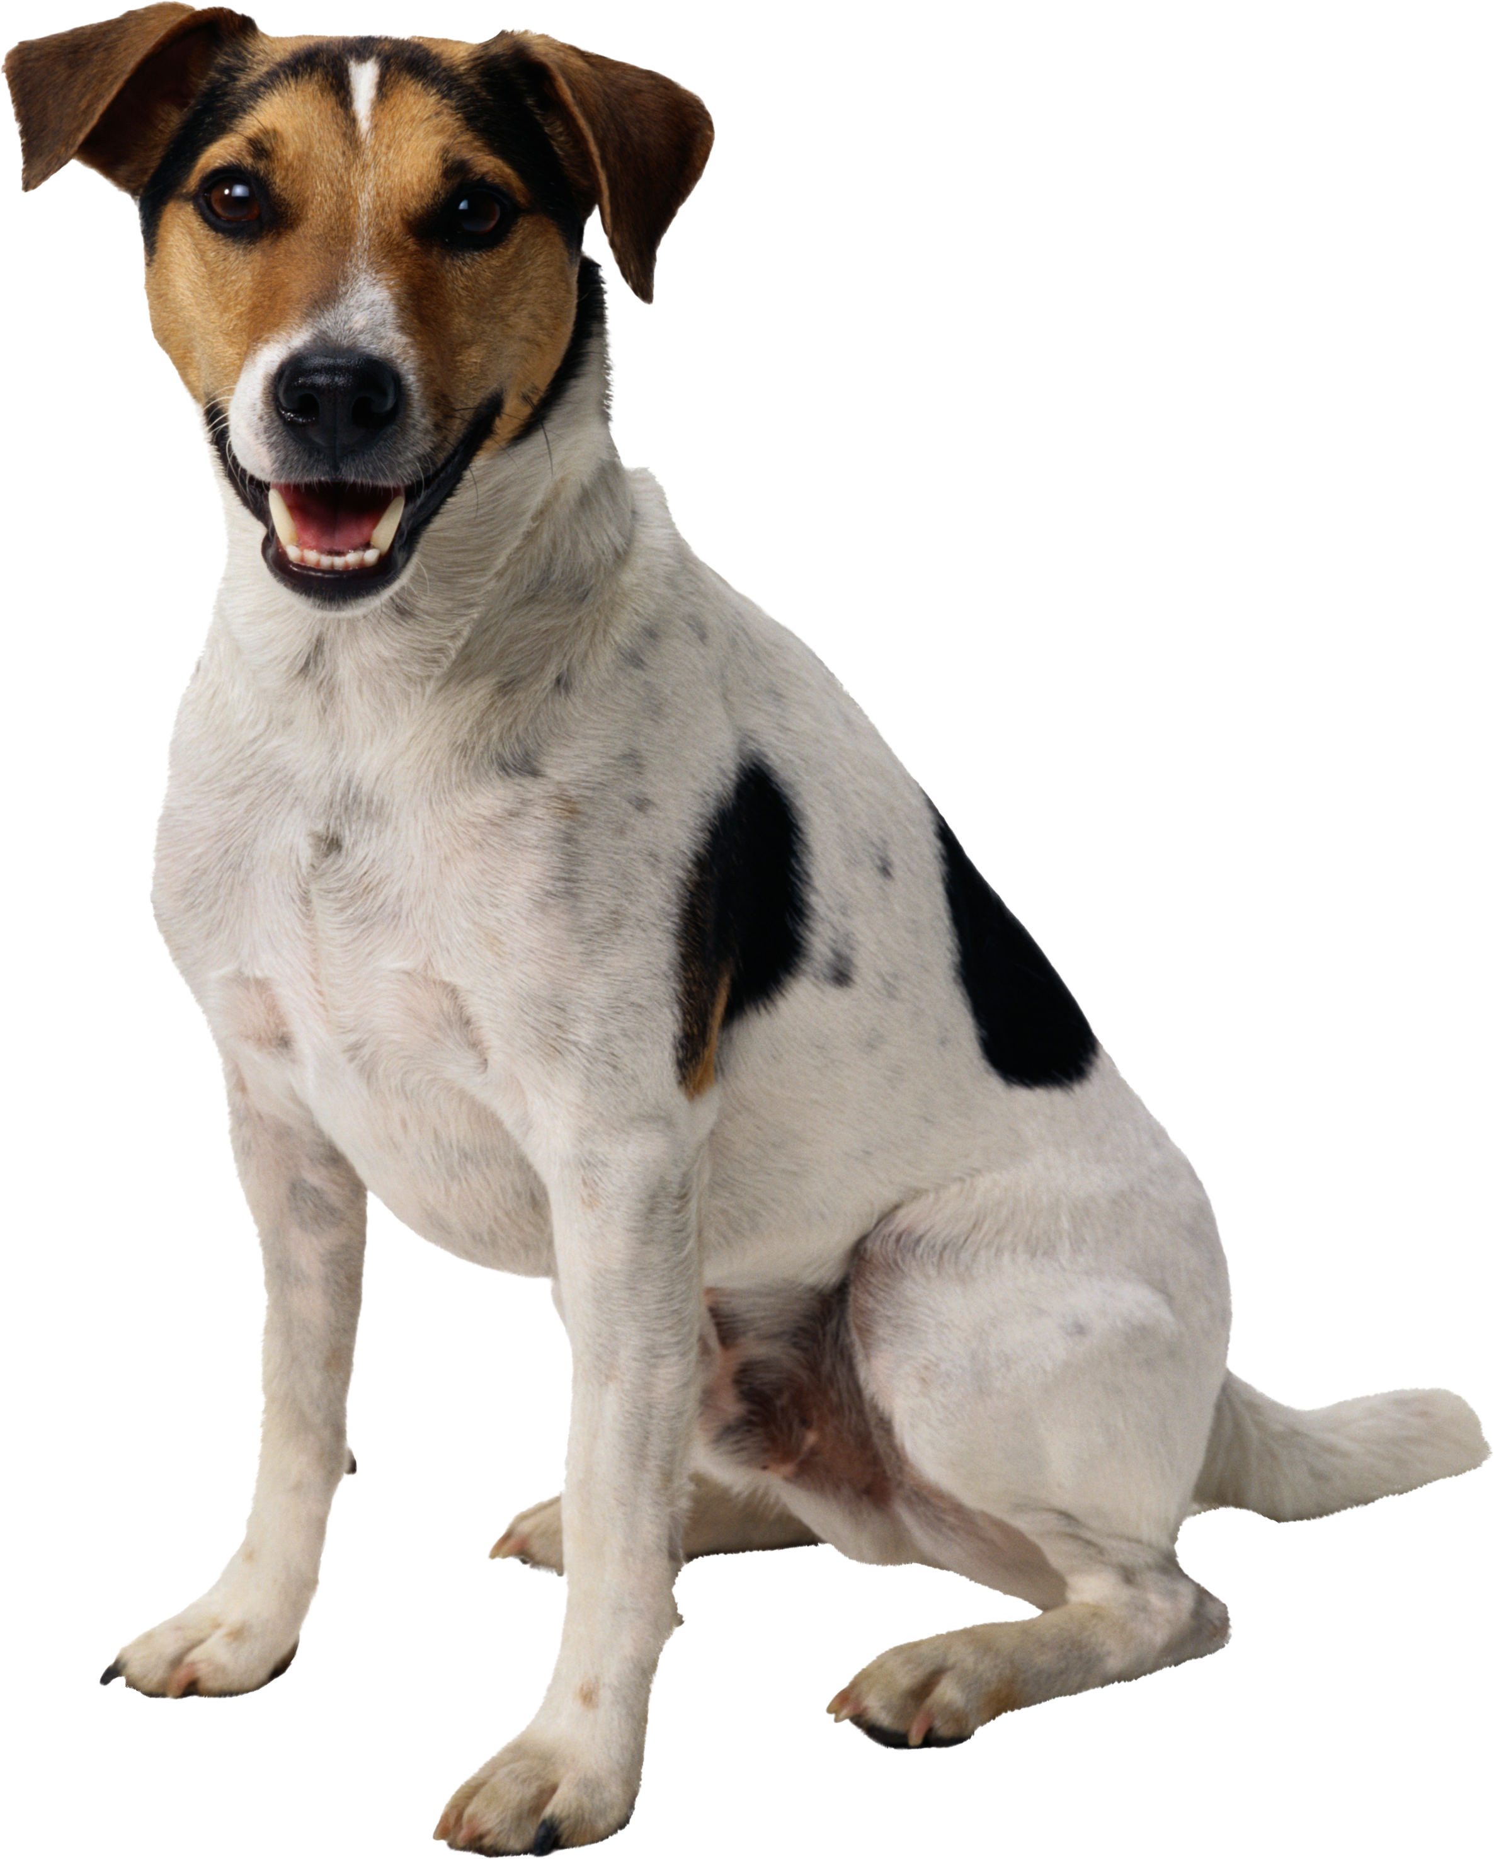

What is discrimination?
Expected discrimination
Unexpected discrimination
Behavioral sensitivity
- "ascending order" vs. "smallest to largest"
fairness-related discrimination
Classifier
$150,000
Loan
software
Classifier
$150,000
Loan
software

Slide 7
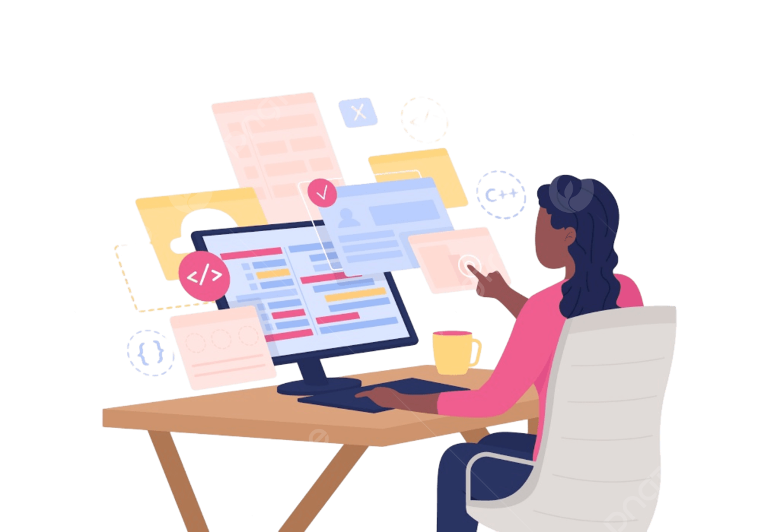
Discrimination testing
Discrimination testing helps answer the question
Does changing attribute X change system behavior?
As such, discrimination testing is not always fairness testing.
In fairness testing, attribute X is a protected attribute (e.g., race).
But attribute X could be anything.

Slide 8



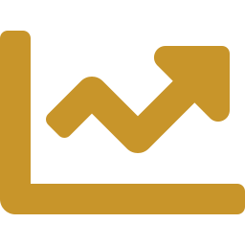
TOOL INTRODUCTION · WORKFLOW
How Automated Discriminatory Test Generation Works
From a decision-making program to a measured discrimination score, in five steps.
01
02
03
Identify Attributes
Set Attribute Values
Generate Test Cases
Locate protected attributes and their values in the program under test.
Record attribute value combinations in a parameter file (ACTS_param).
Combine protected attribute values into test cases (t-way); non-protected fields stay fixed.
COMBINATORIAL Tests (2-way)
Test | Race* | Gender* | Income | Credit History
1 | R1 | G1 | $50,000 | Good
2 | R1 | G2 | $50,000 | Good
3 | R2 | G1 | $50,000 | Good
4 | R2 | G2 | $50,000 | Good
04
Compare Outcomes
Compare decisions across demographic groups for each test case.
* R1/R2 and G1/G2 represent different values of two protected attributes (e.g., race, gender) — every other field stays fixed.
05 · RESULT
GROUP 1 APPROVAL RATE
GROUP 2 APPROVAL RATE
POTENTIAL DISCRIMINATION
x%
y%
x − y%

Slide 9
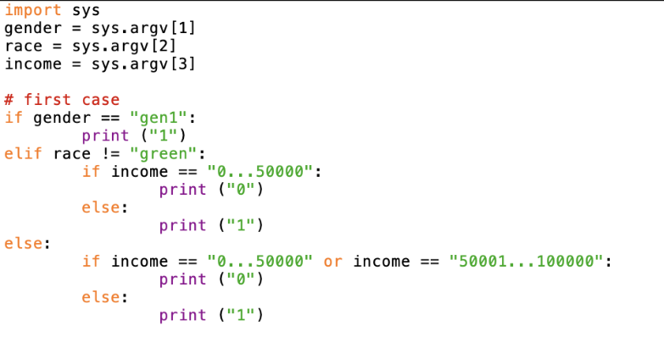
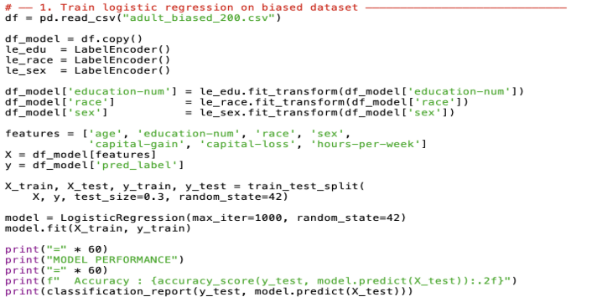
Today's exercise
Testing software for fairness-related discrimination
Rule-based Software Data-driven Software

Slide 10
Today's exercise
Testing software for fairness-related discrimination
Think about:
How can we use existing tools and SE skills to support this form of testing?
What additional support or knowledge is needed to support (and teach about) this kind of testing in practice?

Slide 11
Extra Credit Opportunity
Consent to use of your exercise responses
Extra credit on final project (individual, not group)
XXX

